Slide 1
ENG4118/5326 - Robotics 4/M Sensors, Actuators and Image capture, processing and analysis
Lecture 3
Kevin Worrall

Slide 2
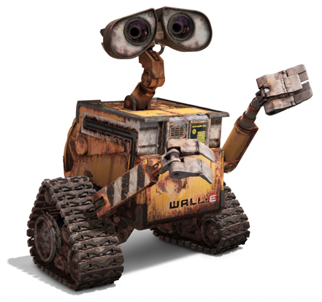
Overview
End of Lecture 2
Various Sensor Specifications

Slide 3
Sensor Specifications Continued

Slide 4
Error
Error
defined as the difference between the sensor output and the true value of the quantity being read
Returned value is 23°C, true is 21°C error is (23-21) 2°C
Error is sometimes used to describe other aspects of the sensor... better to be specific... detail later!

Slide 5
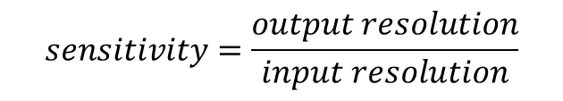
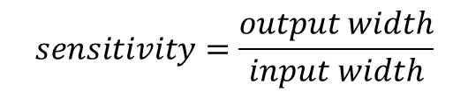
Sensitivity
How much the output changes by when the input changes
Relationship between the output and input:
But can also be used to describe effect on input from environmental changes
Pressure sensor may have a temperature sensitivity of ±0.1% per °C
Assuming fixed output span
Static Response curves with high sensitivity have small input range
Static Response curves with low sensitivity have large input range
$$sensitivity=\frac{output width}{input width}$$
$$sensitivity=\frac{output resolution}{input resolution}$$

Slide 6
Sensitivity
Small input width
Large input width
Fixed Width

Slide 7
Hysteresis
Some sensors can give different readings for the same input depending on the whether the sensor input was increasing or decreasing
Reading is based on the current input as well as the history of inputs
Not necessarily a bad thing, depending on application
...but ideal would be not to have any

Slide 8
Hysteresis

Slide 9

Non-Linearity Error
Normally a linear relationship is assumed between input and output
This is not usually the case, and the maximum difference between the ideal linear relationship and the actual value is the Non-Linearity Error
Typically quoted as a percentage
Non-linearity Error is ±0.05%
Method used to calculate linear relationship
Was the line drawn between the max' and min' values?
Was it drawn through the zero point?
Best fit for a range of points?
Assumed operating point?
$$y=m⋅x+c$$

Slide 10

Repeatability
Ability to give the same output for repeated applications of the same input
Another percentage:
Repeatability is limited by hysteresis and noise
If repeatability is good, then noise and hysteresis must be small
$$repeatability=\frac{max′value−min′value}{fullrange}×100$$

Slide 11
Stability and Drift
Stability
Is the ability to give the same output for the same constant input over a period
Drift
the change in output over time given a constant input
Bias Drift is most common, where output shifts by a constant amount over time
Result of short-term environmental effects (Temperature, pressure)
Long term wear and tear (ageing, fatigue, exposure)

Slide 12
Drift

Slide 13
Dead-Band and Dead-time
Dead-Band
the range of the input variable for which there is no output.
Pressure sensors exhibit a dead-band where the external pressure must be at a level to result in a change within the sensor
Dead-Time
time taken between the application of the input to the time where the output responds.

Slide 14
Resolution
As the input changes the output changes
The steps in which the output changes by are defined by the resolution
Resolution is the smallest change in the input value that will result in a change in the output value

Slide 15
Dynamic range
Dynamic range
defined as the ratio between the largest and smallest possible values of the sensor’s input or output.
It is directly proportional to input span and output span
It is inversely proportional to output resolution and input resolution

Slide 16
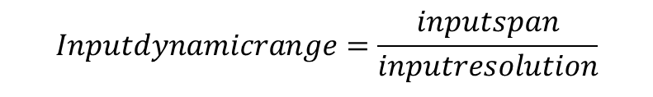
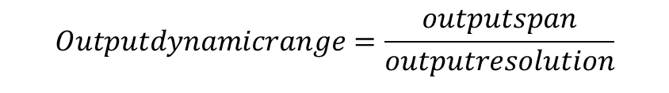
Input and Output dynamic range
Input dynamic range is the ratio between input span and smallest distinguishable input variation
Output dynamic range is the ratio between output span and smallest distinguishable output variation
$$Outputdynamicrange=\frac{outputspan}{outputresolution}$$
$$Inputdynamicrange=\frac{inputspan}{inputresolution}$$

Slide 17
Noise
A random signal imposed on the signal generated by the sensor
Can arise from
external disturbances
within the sensor
Always present
Difficult to remove
Noise can create an envelope of static response curves

Slide 18
Noise

Slide 19
Static Calibration
Process of determining an approximation for the static response curve
Process may require a calibrated true sensor to establish test input
Series of repeated tests to build an average curve...
Error between static curve and static calibration curve is calibration error
Accuracy of static calibration curves is quantifiable in terms of either output error or input error

Slide 20
Static Calibration
With a calibration curve
For simple curves:
Output error = sensor output – calibration output
Calibration output = sensor output – output error
Create an equation that represents the curve, and you calculate the true output based on the output

Slide 21
Static Calibration

Slide 22
Static Calibration
Process
Design experiment
Ensure experimental equipment is suitable
Either create the correct output or can measure the required parameter to a higher degree than the sensor under test
Run experiment logging the real input (via appropriate equipment) and sensor output
Repeat the experiment to allow an average to be extracted
Compare the inputs and outputs and calculate the various errors
Document the process, the test parameters, and the test conditions

Slide 23
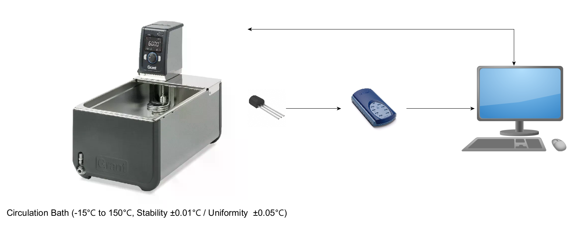
Static Calibration - Example
And what does this do?
Sensor will only be as good as this

Slide 24
Sensor Connection

Slide 25
Sensor Connection
Need to be aware that your sensor needs to connect to something
Logging system
Communication bus
Microcontroller
Analog to digital convertor
…
Expectation is that this connection will be perfect
What the sensor reads is what the system that is connected to it reads
…but…
You are introducing additional sources of everything we have discussed

Slide 26
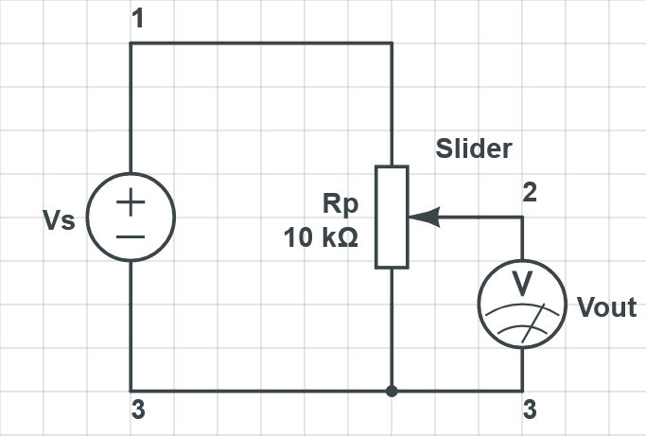
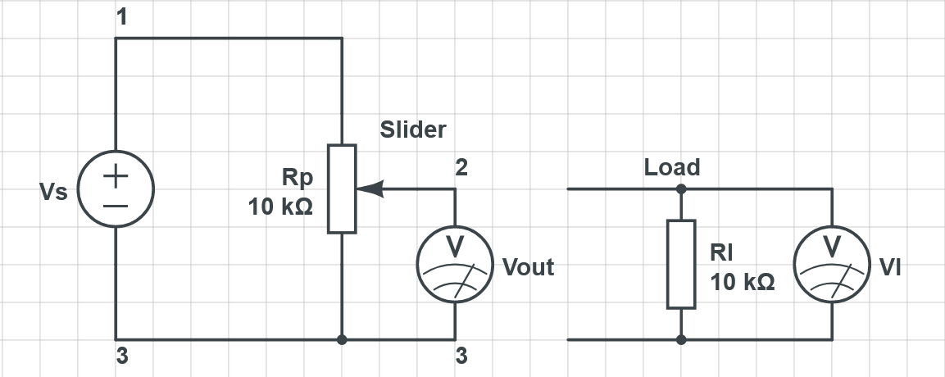
Sensor Connection
Most common example is a sensor that outputs a voltage…
More on this particular example later but there is an instant change…
Your output is no longer a relationship between Vs and Vout (as you will find in a data sheet) but actually Vs and VI
But…

Slide 27
Sensor Connection
Voltage and current measurements need an interface
Impedance
Noise
Pins, wires, connectors, cable lengths… can all impact
Is your analogue interface suitable?
does your Analogue to Digital converter have a good resolution?
But what about digital interfaces?
Timing – is your sensor the only one on the bus?
Can you detect and react within a suitable timeframe?
What is the actual speed of the network and the actual time stamp?
If you have a 24-bit output from a signal but a 16-bit processor – how do you ensure that you don’t lose information?

Slide 28
Sensor Modelling

Slide 29

Sensor Modelling
It can help to consider a single sensor as a system
Input
Disturbances
Desired
Output
Fundamentally a general sensor equation can be given as:
$$y=f\left(a,x\right)+c$$
Where y is the output, f is a sensor function, x is the sensor input, a represents internal parameters, c is a constant

Slide 30
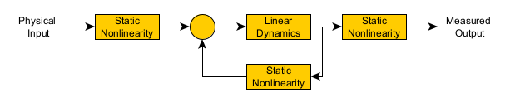
Sensor Modelling
There are general models of sensors
Hammerstien-Wiener feedback model is one

Slide 31
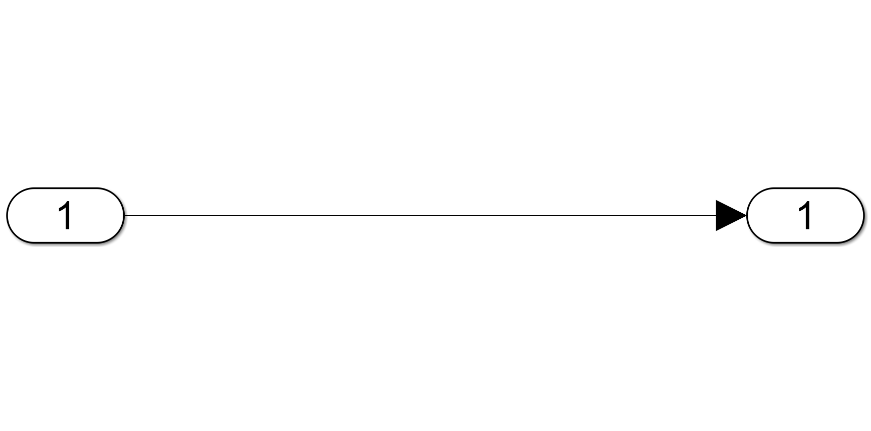
Sensor Modelling
Input
Output

Slide 32
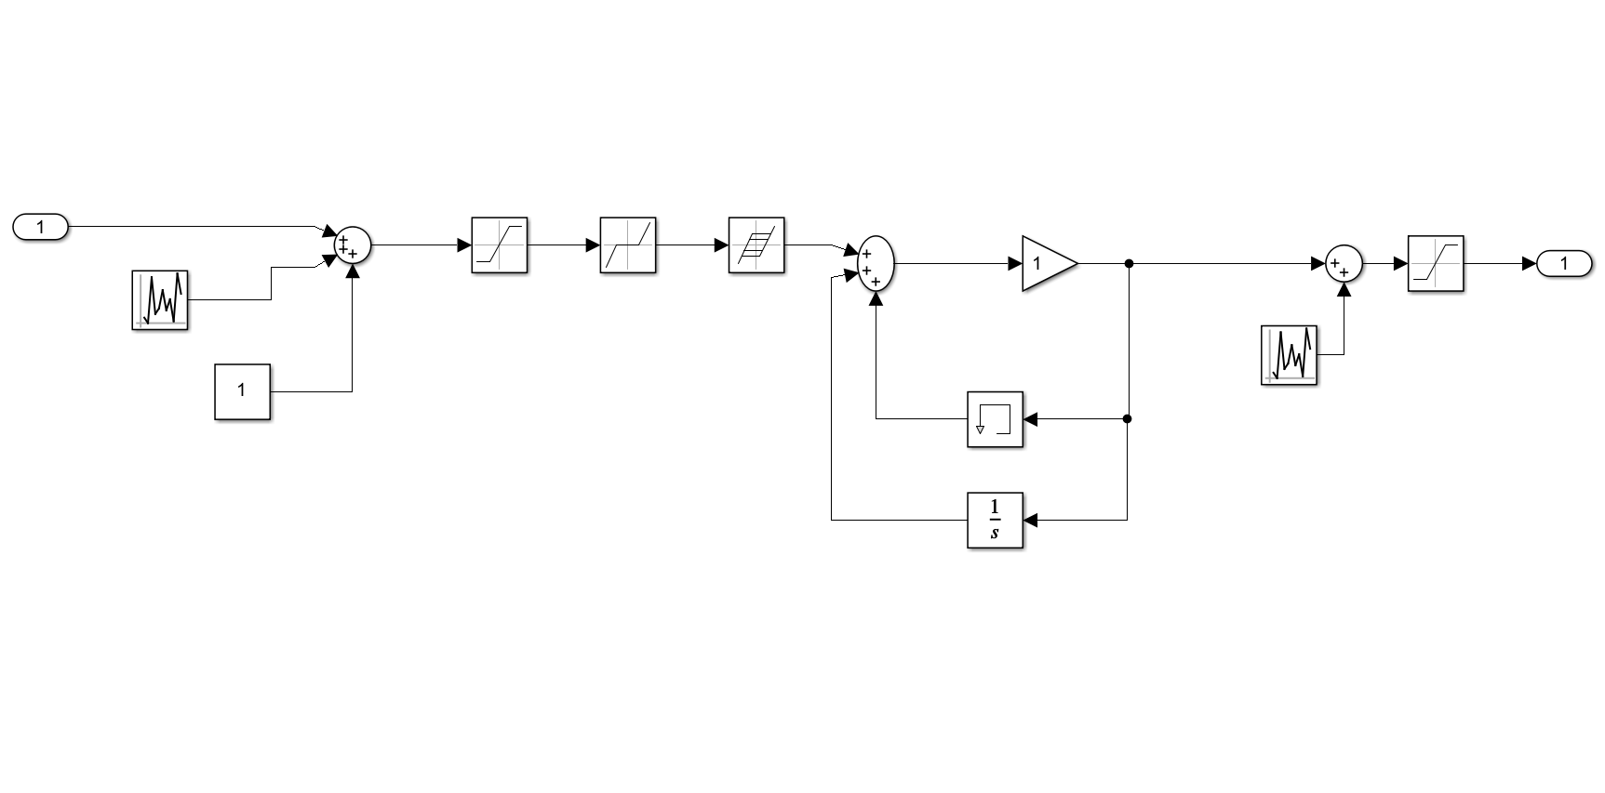
Sensor Modelling
Input
Saturation
Hysteresis
Saturation
Dead band
Output
Noise
Noise
Bias
Previous Measurements
And that’s before you factor in the connection

Slide 33
Example

Slide 34
Temperature Sensor – LMT86
Accurate - ±0.4°C but maximum ±2.7°C
Gain -10.9mv/°C
Range -50°C to 150°C
Thermal time constant 10s (1.2m/s airflow)
Various other but these are the important parameters for us
So what does this mean?

Slide 35
Temperature Sensor – LMT86

Slide 36
Temperature Sensor – LMT86

Slide 37
Temperature Sensor – LMT86

Slide 38
Temperature Sensor – LMT86

Slide 39
Temperature Sensor – LMT86
Conversion of voltage
Output voltage – 2616mV to 420mV (-50°C to 150°C)
Need to detect about 1mV
8 bit AtoD – 256 discreet (assuming 3V reference) 11.7mV… this can be done… but only ever going to get 1°C as a result of the calibration data available in the datasheet.

Slide 40
Examples
Further examples will be made available

Slide 41
Review
Stability and Drift
Dead band and Dead Time
Resolution
Dynamic Range
Input and Output Dynamic Range
Noise
Static Calibration
Sensor Connection
Sensor Modelling

Slide 42
References
Please read:
Bernstein, D. S. “A student’s guide to sensor performance specifications”, IEEE Control Systems Magazine, 21, 4, 9-18, 2001
Bernstein, D. S. Sensor Performance Specifications, IEEE Control Systems Magazine, 21, 4, 9-18, 2001
Bolton, W., Mechatronics, 5th Edition, Pearson, 2012
Chapter 2 - Sections 2.1 and 2.2
Niku, S.B. , Introduction to Robotics, 2nd Edition, Wiley, New Jersey, 2011.

